Slide 1
Network Transport Layer:
AIMD; TCP/Reno
  Qiao Xiang, Congming Gao, Qiang Su
  https://sngroup.org.cn/courses/cnns-xmuf25/index.shtml
  11/06/2025
This deck of slides are heavily based on CPSC 433/533 at Yale University, by courtesy of Dr. Y. Richard Yang.

Slide 2
Recap: Transport Design
Basic structure/reliability: sliding window protocols
Determine the “right” parameters
  Timeout
    mean + variation
  Sliding window size
    Related w/ congestion control or more generally resource allocation
      Bad congestion control can lead to congestion collapse (e.g., zombie packets)
    Goals: distributed algorithm to achieve fairness and efficiency

Slide 3
Three Way Handshake (TWH) [Tomlinson 1975]
Host A
Host B
SYN(seq=x)
notify initial seq#. Accept?
ACK(seq=x), SYN(seq=y)
think of y as a challenge
ACK(seq=y)
accept data only after
verified y is bounced back
x is the init. seq
DATA(seq=x+1)
SYN: indicates connection setup
Notes:
Syn(seq=x) could be duplicate or malicious

Slide 4
Time_Wait Design Options
Design 1 (initiator time wait)
Design 2 (receiver time wait)
Host A
Host B
Host A
Host B
close
FIN
close
FIN
Time = n x timeout
Time to retry FIN
after each timeout
Close after receive FIN
All states removed
ACK
Time to retransmit
ACK
Close after
first ACK
All states removed
ACK
All states removed
All states removed

Slide 5
TCP Four Way Teardown
(For Bi-Directional Transport)
Host A
Host B
propose close
A->B
close
FIN
A->B closed
ACK
close
propose close
B->A
A->B closed
FIN
ACK
can retransmit the
ACKif its ACK is lost
timed wait
closed
all states removed
closed
all states removed

Slide 6
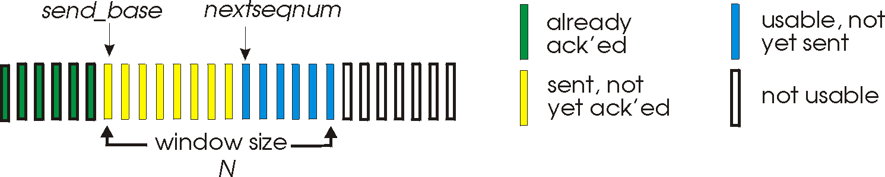
Sliding Window Size Function: Rate Control
Transmission rate determined by congestion window size, cwnd, over segments:
cwnd
cwnd segments, each with MSS bytes sent in one RTT:
cwnd * MSS
Rate =
Bytes/sec
RTT
Assume W is small enough. Ignore small details. MSS: Minimum Segment Size

Slide 7
Some General Questions
Big picture question:
How to determine a flow’s sending rate?
For better understanding, we need to look at a few basic questions:
What is congestion (cost of congestion)?
Why are desired properties of congestion control?

Slide 8
Outline
Admin and recap
TCP Reliability
Transport congestion control
  what is congestion (cost of congestion)

Slide 9
Cause/Cost of Congestion: Single Bottleneck
flow 1
20 Mbps
5 Mbps
10 Mbps
flow 2 (5 Mbps)
20 Mbps
20 Mbps
router 1
router 2
- Flow 2 has a fixed sending rate of 5 Mbps
- We vary the sending rate of flow 1 from 0 to 20 Mbps
- Assume
  no retransmission; link from router 1 to router 2 has infinite buffer
throughput: e2e packets delivered in unit time
Delay?
throughput of
flow 1 & 2 (Mbps)
delay at central link
delay due to
randomness
10
sending rate
by flow 1 (Mbps)
sending rate
by flow 1 (Mbps)
5
0
5
5
0

Slide 10
Cause/Cost of Congestion: Single Bottleneck
router 3
router 5
flow 1
20 Mbps
5 Mbps
10 Mbps
flow 2 (5 Mbps)
20 Mbps
20 Mbps
router 1
router 2
router 4
router 6
Assume
  no retransmission
  the link from router 1 to router 2 has finite buffer
  throughput: e2e packets delivered in unit time
Zombie packet: a packet dropped at the link from router 2 to router 5; the upstream transmission from router 1 to router 2 used for that packet was wasted!
throughput of
flow 1 & 2 (Mbps)
10
sending rate
by flow 1 (Mbps)
5
x
0
5

Slide 11
Summary: The Cost of Congestion
When sources sending rate too high for the network to handle”:
Packet loss =>
  wasted upstream bandwidth when a pkt is discarded at downstream
  wasted bandwidth due to retransmission (a pkt goes through a link multiple times)
High delay
packet
loss
knee
cliff
Throughput
congestion
collapse
Load
Delay
Load

Slide 12
Outline
Admin and recap
TCP Reliability
Transport congestion control
  what is congestion (cost of congestion)
  basic congestion control alg.

Slide 13
Rate-based vs. Window-based
Rate-based:
Congestion control by explicitly controlling the sending rate of a flow, e.g., set sending rate to 128Kbps
Example: ATM
Window-based:
Congestion control by controlling the window size of a sliding window, e.g., set window size to 64KBytes
Example: TCP
Discussion: rate-based vs. window-based

Slide 14
Sliding Window Size Function: Rate Control
Transmission rate determined by congestion window size, cwnd, over segments:
cwnd
cwnd segments, each with MSS bytes sent in one RTT:
cwnd * MSS
Rate =
Bytes/sec
RTT
Assume W is small enough. Ignore small details. MSS: Maximum Segment Size

Slide 15
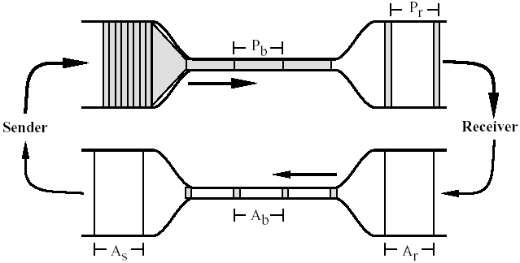
Window-based Congestion Control
Window-based congestion control is self-clocking: considers flow conservation, and adjusts to RTT variation automatically.
Hence, for better safety, more designs use window-based design.

Slide 16
The Desired Properties of a
Congestion Control Scheme
Efficiency: close to full utilization but low delay
  fast convergence after disturbance
Fairness (resource sharing)
Distributedness (no central knowledge for scalability)

Slide 17
Derive CC: A Simple Model
User 1
x₁
d =
sum x_{i} > X_{goal}?
sum xi
User 2
x₂
x_{n}
User n
Flows observe congestion signal d, and locally take
actions to adjust rates.

Slide 18
Linear Control
Proposed by Chiu and Jain (1988)
The simplest control strategy
Discussion: values of the parameters?

Slide 19
State Space of Two Flows
fairness line: x1=x2
x₂
x(0)
overload
efficiency line: x1+x2=C
underload
x₁

Slide 20
congestion
x₀
x₀
a=0
b=1
efficiency
efficiency: distributed linear rule
a=0
b=1
x₀
x₀
fairness
intersection

Slide 21
Implication: Congestion (overload) Case
In order to get closer to efficiency and fairness after each update, decreasing of rate must be multiplicative decrease (MD)
  a_{D} = 0
  b_{D} < 1

Slide 22
no-congestion
x₀
x₀
efficiency
efficiency: distributed linear rule
x₀
x₀
fairness
convergence

Slide 23
Implication: No Congestion Case
In order to get closer to efficiency and fairness after each update, additive and multiplicative increasing (AMI), i.e.,
  a_{I} > 0, b_{I} > 1
Simply additive increase gives better improvement in fairness (i.e., getting closer to the fairness line)
Multiplicative increase may grow faster

Slide 24
Intuition: State Trace Analysis
of Four Special Cases
 | Additive Decrease | Multiplicative Decrease
Additive Increase | AIAD (b_{I}=b_{D}=1) | AIMD (b_{I}=1, a_{D}=0)
Multiplicative Increase | MIAD (a_{I}=0, b_{I}>1, b_{D}=1) | MIMD (a_{I}=a_{D}=0)
Discussion: state transition trace.

Slide 25
AIMD: State Transition Trace
x₂
fairness line:
x1=x2
overload
x₀
efficiency line: x1+x2=C
underload
x₁

Slide 26
Intuition: Another Look
Consider the difference or ratio of the rates of two flows
  AIAD
    difference does not change
  MIMD
    ratio does not change
  MIAD
    difference becomes bigger
  AIMD
    difference does not change
Notes:
AIAD: difference does not change
MIMD: ratio does not change
MIAD: difference becomes bigger
AIMD: difference does not change

Slide 27
Outline
Admin and recap
TCP Reliability
Transport congestion control
  what is congestion (cost of congestion)
  basic congestion control alg.
  TCP/reno congestion control

Slide 28
TCP Congestion Control
Closed-loop, end-to-end, window-based congestion control
Designed by Van Jacobson in late 1980s, based on the AIMD alg. of Dah-Ming Chu and Raj Jain
Worked in a large range of bandwidth values: the bandwidth of the Internet has increased by more than 200,000 times
Many versions
  TCP/Tahoe: this is a less optimized version
  TCP/Reno: many OSs today implement Reno type congestion control
  TCP/Vegas: not currently used
For more details: see TCP/IP illustrated; or read
http://lxr.linux.no/source/net/ipv4/tcp_input.c for linux implementation

Slide 29
Mapping A(M)I-MD to Protocol
Basic questions to look at:
  How to obtain d(t)--the congestion signal?
  What values do we choose for the formula?
  How to map formula to code?
Notes:
Implement d(t): loss/delay
Adjust window size
b_D: exponential backoff timeout after window size is 1

Slide 30
Obtain d(t) Approach 1: End Hosts
Consider Loss as Congestion
Packets
1
2
3
4
5
6
7
Acknowledgements (waiting seq#)
2
3
4
4
4
4
Pros and Cons of endhosts using loss as congestion?
Assume loss
=> cong

Slide 31

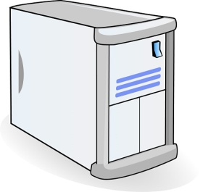
Obtain d(t) Approach 2: Network Feedback (ECN: Explicit Congestion Notification)
Sender reduces rate if
ECN received.
Pros and Cons of ECN?
Sender 1
Receiver bounces marker back to sender in ACK msg
Receiver
Sender 2
Network marks ECN Mark (1 bit) on pkt according
to local condition, e.g., queue length > K

Slide 32
Mapping A(M)I-MD to Protocol
Basic questions to look at:
  How to obtain d(t)--the congestion signal?
  What values do we choose for the formula?
  How to map formula to code?
Notes:
Implement d(t): loss/delay
Adjust window size
b_D: exponential backoff timeout after window size is 1

Slide 33
TCP/Reno Formulas
Multiplicative Increase (MI)
  double the rate: x(t+1) = 2 x(t)
Additive Increase (AI)
  Linear increase the rate: x(t+1) = x(t) + 1
Multiplicative decrease (MD)
  half the rate: x(t+1) = 1/2 x(t)

Slide 34
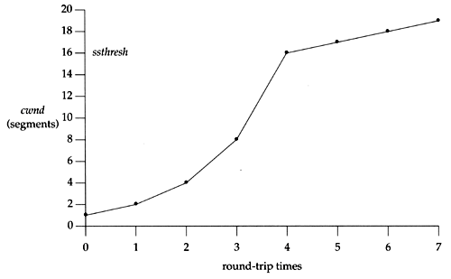
TCP/Reno Formula Switching
(Control Structure)
Two “phases”
  slow-start
    Goal: getting to equilibrium gradually but quickly, to get a rough estimate of the optimal of cwnd
    Formula: MI
  congestion avoidance
    Goal: Maintains equilibrium and reacts around equilibrium
    Formula: AI MD

Slide 35
TCP/Reno Formula Switching
(Control Structure)
Important variables:
  cwnd: congestion window size
  ssthresh: threshold between the slow-start phase and the congestion avoidance phase
If cwnd < ssthresh
  MI
Else
  AIMD
Notes:
AI: increases window by 1 per round
MD: cuts window size
to half when detecting congestion by 3DUP
to 1 if timeout
if already timeout, doubles timeout

Slide 36
MI: Slow Start
Algorithm: MI
  double cwnd every RTT until network congested
  Goal: getting to equilibrium gradually but quickly, to get a rough estimate of the optimal of cwnd

Slide 37
MI: Slow-start
Initially:
cwnd = 1;
ssthresh = infinite (e.g., 64K);
For each newly ACKed segment:
if (cwnd < ssthresh)
/* MI: slow start*/
cwnd = cwnd + 1;
cwnd = 1
segment 1
ACK for segment 1
cwnd = 2
segment 2
segment 3
ACK for segments 2 + 3
cwnd = 4
segment 4
segment 5
segment 6
segment 7
cwnd = 6
cwnd = 8

Slide 38
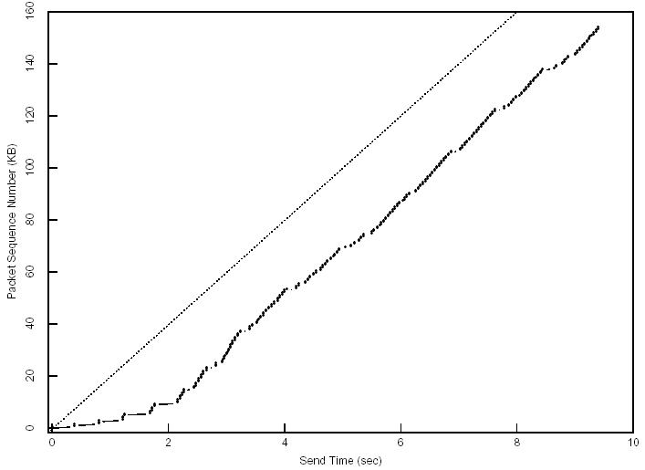
Startup Behavior with Slow-start
See [Jac89]

Slide 39
AIMD: Congestion Avoidance
Algorithm: AIMD
  increases window by 1 per round-trip time (how?)
  cuts window size
    to half when detecting congestion by 3DUP
    to 1 if timeout
    if already timeout, doubles timeout
    Goal: Maintains equilibrium and reacts around equilibrium

Slide 40
TCP/Reno Full Alg
Initially:
cwnd = 1;
ssthresh = infinite (e.g., 64K);
For each newly ACKed segment:
if (cwnd < ssthresh) // slow start: MI
cwnd = cwnd + 1;
else
// congestion avoidance; AI
cwnd += 1/cwnd;
Triple-duplicate ACKs:
// MD
cwnd = ssthresh = cwnd/2;
Timeout:
ssthresh = cwnd/2; // reset
cwnd = 1;
(if already timed out, double timeout value; this is called exponential backoff)

Slide 41
TCP/Reno: Big Picture
cwnd
TD
TD
TD
TO
ssthresh
ssthresh
ssthresh
ssthresh
Time
slow
start
(MI)
congestion
avoidance
(AIMD)
congestion
avoidance
congestion
avoidance
slow
start
congestion
avoidance
TD: Triple duplicate acknowledgements
TO: Timeout

